Slide 1

Session Name:
Constraints in Optimization Problems
Delivered By:
Mr. Ritwik Sinha

Slide 2

Optimization
Constraints are different conditions which restrict the possible solutions of an optimization problems.
Different types of Optimization constraints are:
Equality Constraints
Inequality Constraints
Box Constraints
Linear and Non-Linear Constraints
Hard and Soft Constraints

Slide 3

Learning Objectives
By the end of this session, you will be able to:
Define the optimization Constraints
Discuss different type of optimization Constraints
Define the mathematical implementation of different types of constraints in a feasible region
Discuss the role of constraints in optimization

Slide 4
Constraints effects on Optimization
Constraint Type | Effect on Solution Space | Difficulty in Solving
Equality | Restricts to a lower-dimensional subspace | Medium
Inequality | Defines a feasible region but allows flexibility | Low
Box Constraints | Restricts each variable to a range | Low
Linear | Forms a convex feasible region | Low
Nonlinear | Creates complex, non-convex regions | High
Integer/Binary | Discrete feasible space (requires special solvers) | High
Complementarity | Causes non-convexity, limiting methods | Very High

Slide 5
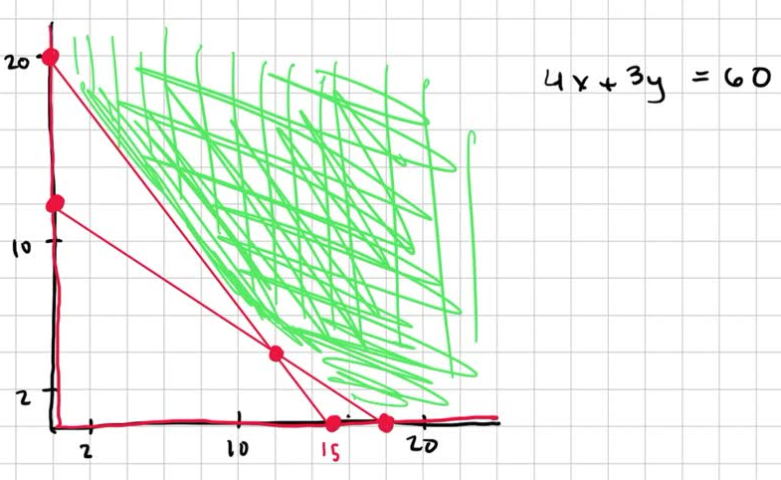
Equality Constraints
Definition – Equality constraints are those constraints which provides an exact relationship between different variables.
Representation – g(x) = 0
Example – While solving an optimization problem of Budget of a country, the total amount shared by individual entities must be equal to the overall budget present with the government
X1 + X2 + X3 +…….+ Xn = 1000
Impact on Solution Space –
Reduces the degree of freedom by enforcing strict constraints
Solution space is a lower dimensional subspace of the original space

Slide 6
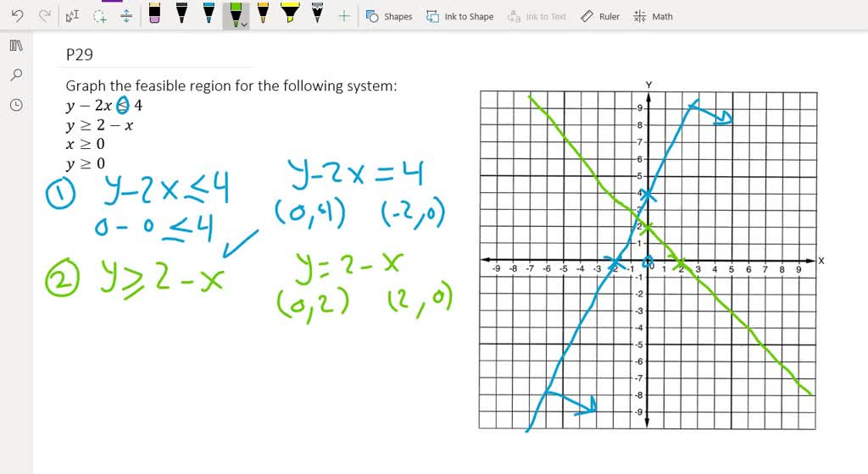
Inequality Constraints
Definition - These constraints limit values but do not fix them exactly.
Representation – g(x) ≤ 0
Example – A factory production cannot exceed 500 units
X1 + X2 ≤ 500
Impact on Solution Space –
Defines a bounded region but does not completely
restrict movement
Active vs. Inactive Constraints: A constraint is active
if it is exactly met (e.g., production = 500), otherwise
it is inactive (e.g., production = 450)

Slide 7
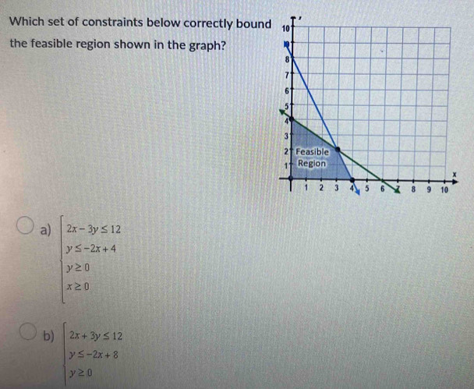
Box Constraints
Definition – These are upper and lower bounds on individual variables
Representation – a ≤ x ≤ b
Example – A warehouse stores at least 50 and at most 300 units
50 ≤ x ≤ 300
Impact on Solution Space –
Prevents variables from taking extreme values
Converts an unbounded problem into a bounded one, making solutions easier to find

Slide 8
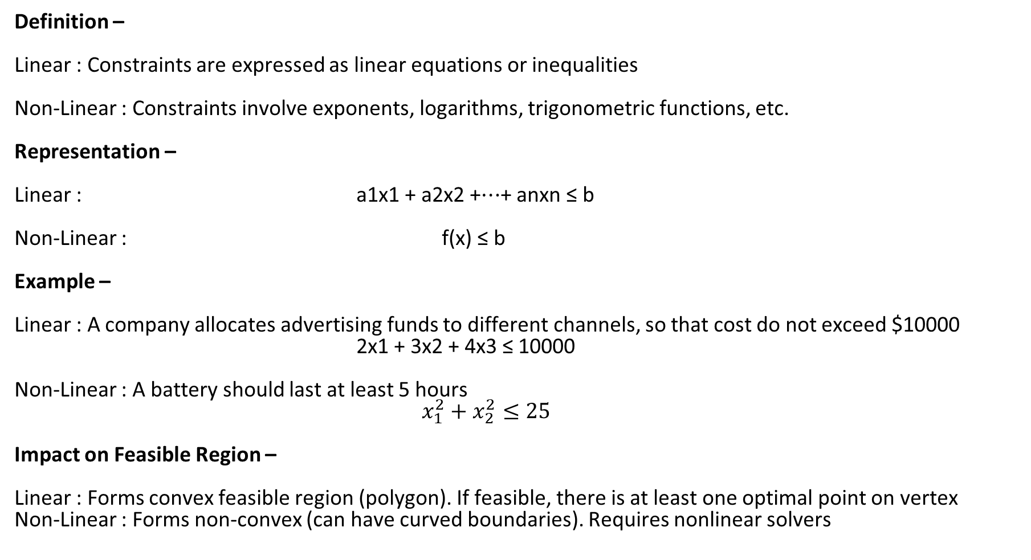
Linear and Non-Linear Constraints
Definition –
Linear : Constraints are expressed as linear equations or inequalities
Non-Linear : Constraints involve exponents, logarithms, trigonometric functions, etc.
Representation –
Linear : a1​x1​ + a2​x2​ +⋯+ an​xn​ ≤ b
Non-Linear : f(x) ≤ b
Example –
Linear : A company allocates advertising funds to different channels, so that cost do not exceed $10000
2x1 + 3x2 + 4x3 ≤ 10000
Non-Linear : A battery should last at least 5 hours
$x_{1}^{2}+x_{2}^{2}≤25$
Impact on Feasible Region –
Linear : Forms convex feasible region (polygon). If feasible, there is at least one optimal point on vertex
Non-Linear : Forms non-convex (can have curved boundaries). Requires nonlinear solvers

Slide 9
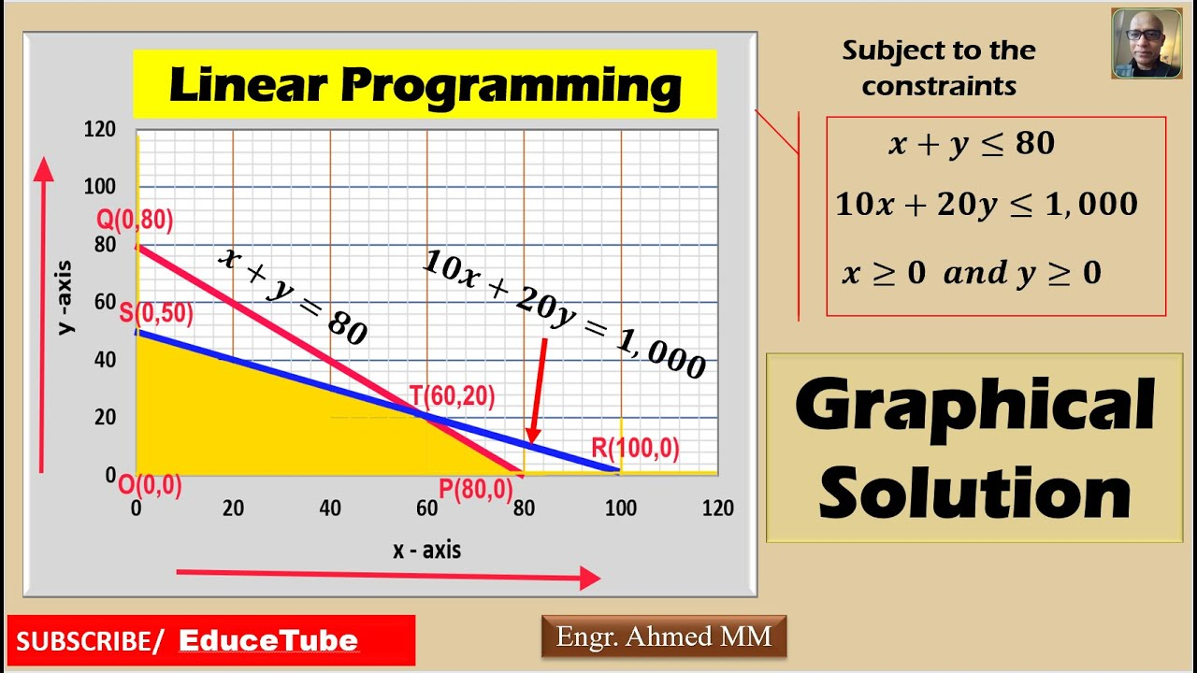
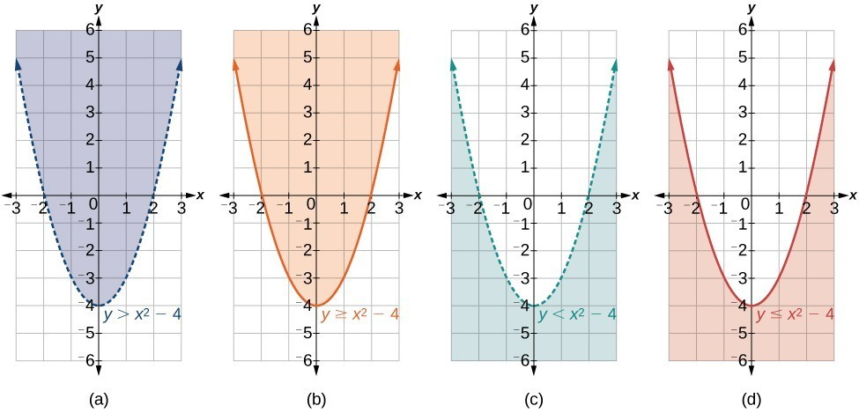
Linear and Non-Linear Constraints

Slide 10
Academic Poll
What happens to the feasible region when more constraints are added to an optimization problem?
A. It always increases in size
B. It always decreases in size or remains the same
C. It remains unchanged
D. It becomes unbounded
In a linear programming problem, what is the effect of an inactive constraint?
A. It does not affect the optimal solution
B. It changes the optimal solution
C. It eliminates all feasible solutions
D. It makes the problem infeasible

Slide 11
Academic Poll
What happens to the feasible region when more constraints are added to an optimization problem?
A. It always increases in size
B. It always decreases in size or remains the same
C. It remains unchanged
D. It becomes unbounded
In a linear programming problem, what is the effect of an inactive constraint?
A. It does not affect the optimal solution
B. It changes the optimal solution
C. It eliminates all feasible solutions
D. It makes the problem infeasible

Slide 12
Academic Poll
If a linear optimization problem has conflicting constraints, what is the most likely outcome?
A. Multiple optimal solutions
B. A unique optimal solution
C. No feasible solution
D. An unbounded solution
Which of the following is true about inequality constraints in optimization problems?
A. They define boundaries but do not restrict feasible solutions
B. They must always be active at the optimal solution
C. They create a feasible region that may be bounded or unbounded
D. They are equivalent to equality constraints

Slide 13
Academic Poll
If a linear optimization problem has conflicting constraints, what is the most likely outcome?
A. Multiple optimal solutions
B. A unique optimal solution
C. No feasible solution
D. An unbounded solution
Which of the following is true about inequality constraints in optimization problems?
A. They define boundaries but do not restrict feasible solutions
B. They must always be active at the optimal solution
C. They create a feasible region that may be bounded or unbounded
D. They are equivalent to equality constraints

Slide 14
Session Summary
In this session, we have discussed about:
Introduction to Types of Constraints in Optimization Problems
Explain different types with Feasible Region Graphs

Slide 15

Happy Learning!

